Slide 1



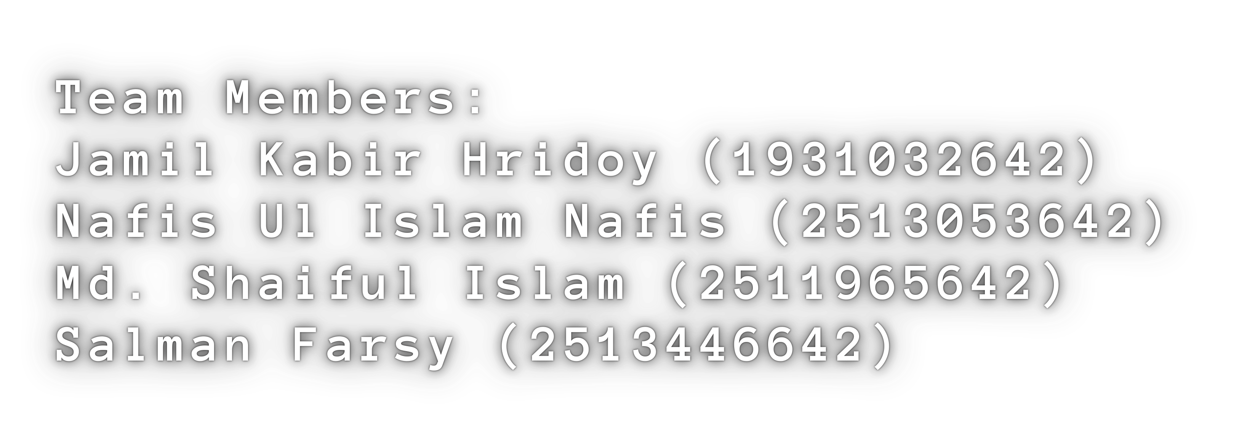

PIXEL ART EDITOR
ADVANCED PIXEL EDITOR IN C USING SDL2
L A Y E R E D , U N D O -
E
C A P A B L E P I X E L A R T T O O L W I T H
X P O R T S U P P O R T

Slide 2
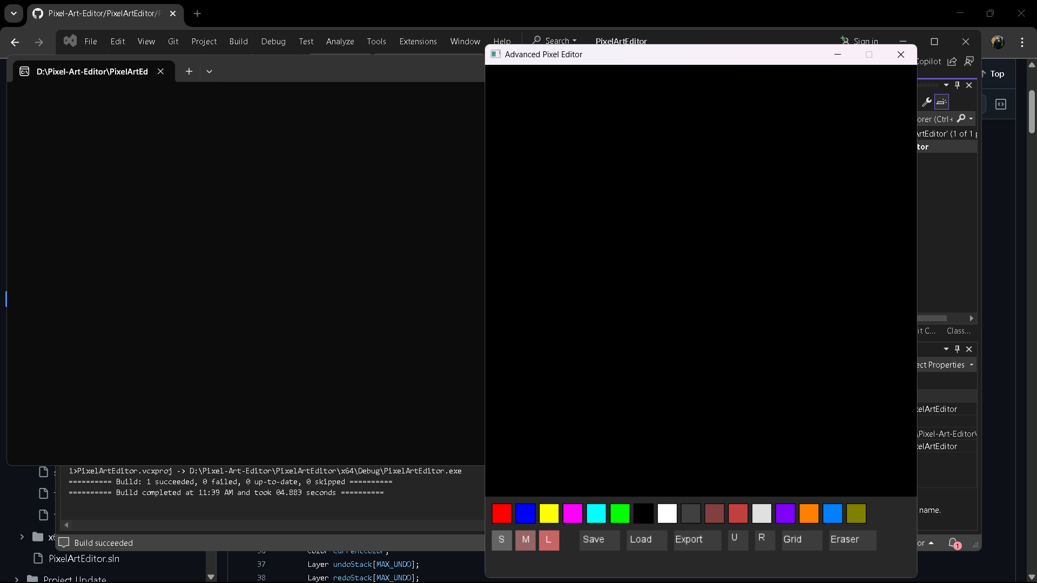
PROJECT 6 JAMIL KABIR HRIDOY NAFIS UL ISLAM NAFIS MD. SHAIFUL ISLAM SALMAN FARSY

Slide 3
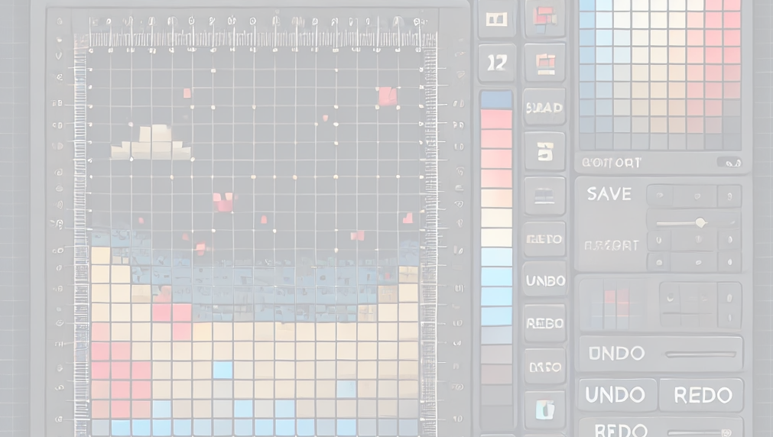
SIGNIFICANCE
we wanted to build something graphical, real-time
And creative C and SDL2 gave full control of performance and design
Focus: tools you’d expect in a real pixel art editor
PROJECT 6 JAMIL KABIR HRIDOY NAFIS UL ISLAM NAFIS MD. SHAIFUL ISLAM SALMAN FARSY

Slide 4
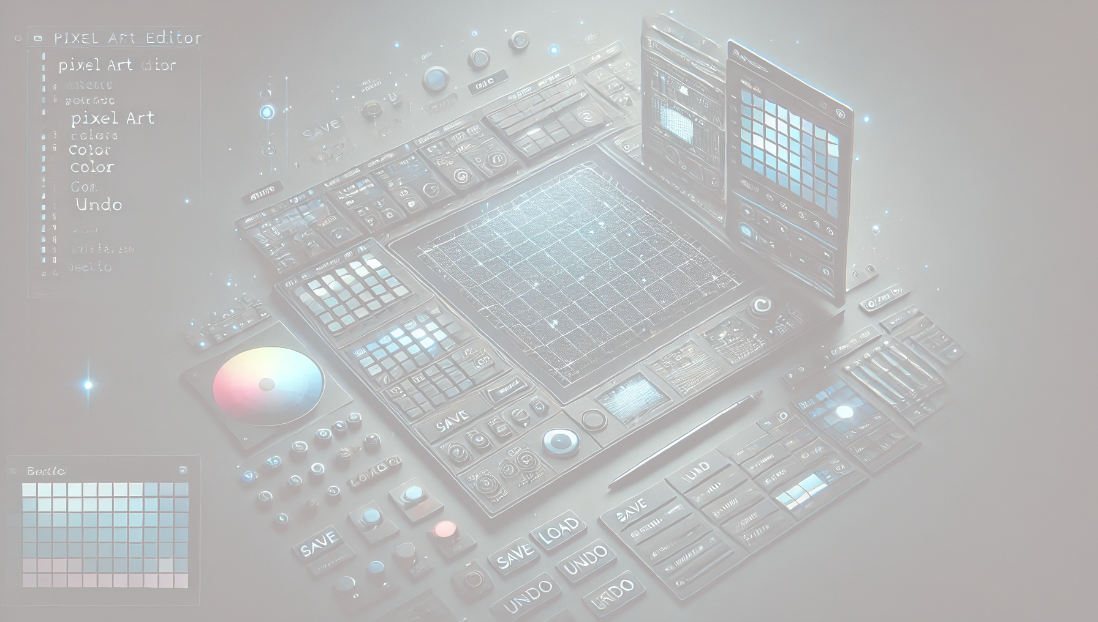


System Overview
32×32 pixel grid Undo/ Redo (up to 10 steps) Multiple Brush Sizes
Eraser + Color Palette (16 colors) Grid toggle
Export to BMP , Save/Load from file
PROJECT 6 JAMIL KABIR HRIDOY NAFIS UL ISLAM NAFIS MD. SHAIFUL ISLAM SALMAN FARSY

Slide 5

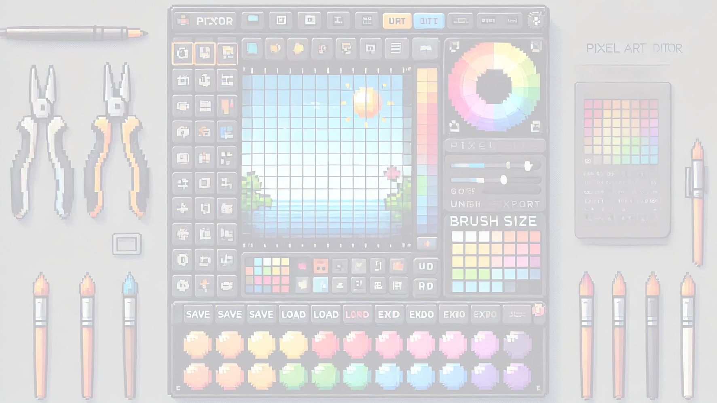
Architecture Overview
EditorState Struct: tracks current layer, brush, colors, history
Layer System: 3 layers, each a 2D color gridE
vent Loop:
handles UI clicks, drawing logic
Rendering: SDL2 + SDL_ttf for canvas + UI
(Diagram: UI, canvas, state)
04
PROJECT 6 JAMIL KABIR HRIDOY NAFIS UL ISLAM NAFIS MD. SHAIFUL ISLAM SALMAN FARSY

Slide 6
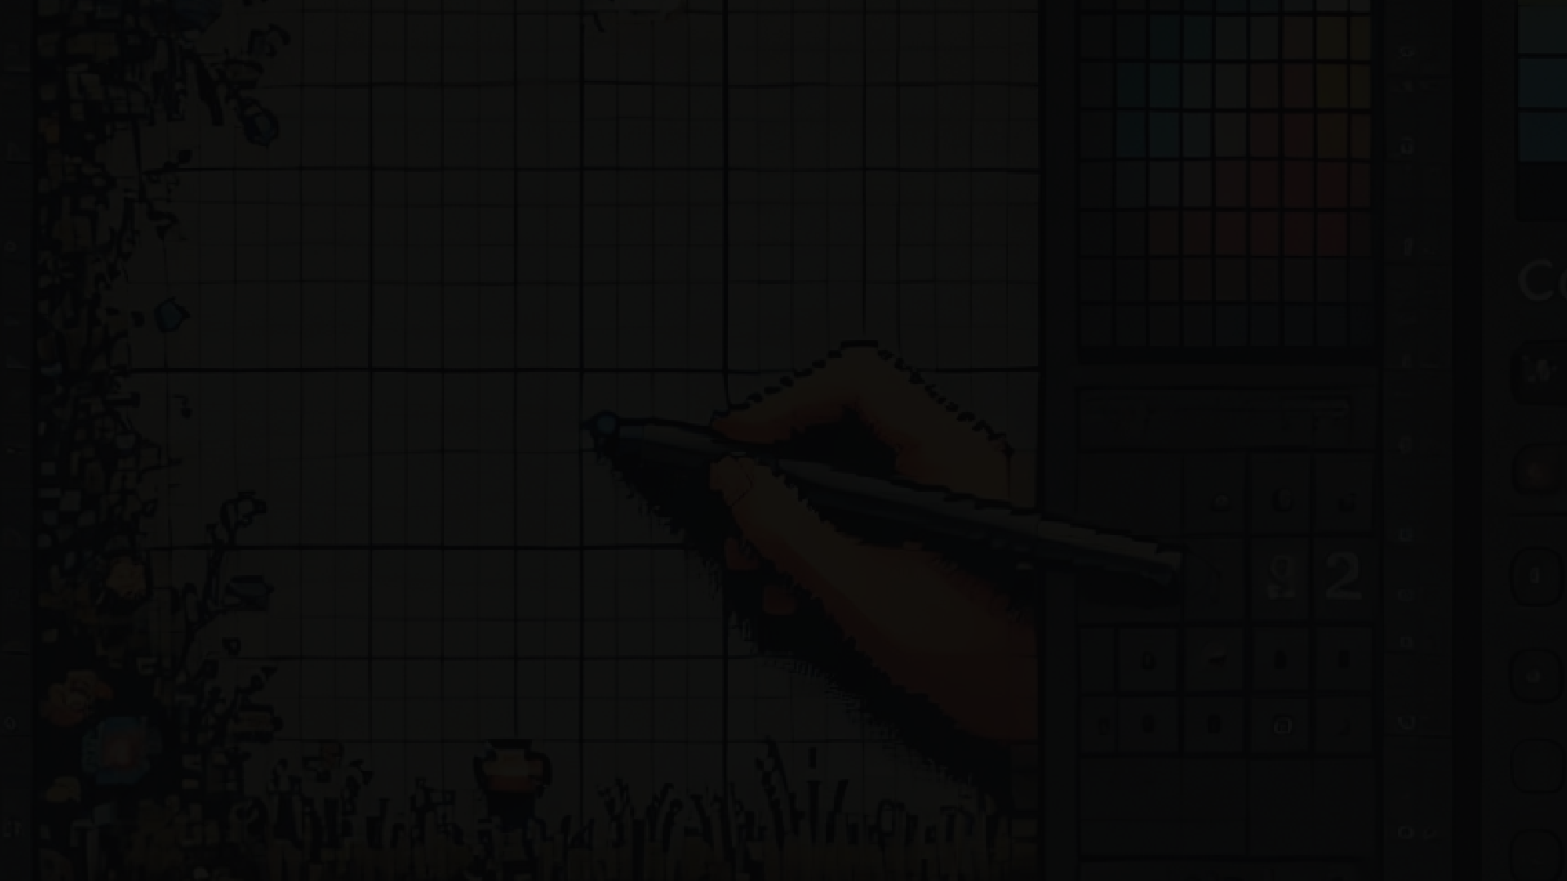
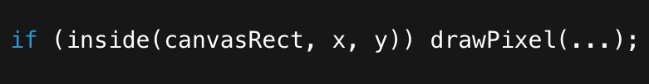




Input Handling
Mouse clicks: canvas or buttons
Drawing only allowed within canvasRect
Brush strokes save one undo per drag
Mouse motion triggers real-time drawing c
PROJECT 6 JAMIL KABIR HRIDOY NAFIS UL ISLAM NAFIS MD. SHAIFUL ISLAM SALMAN FARSY

Slide 7

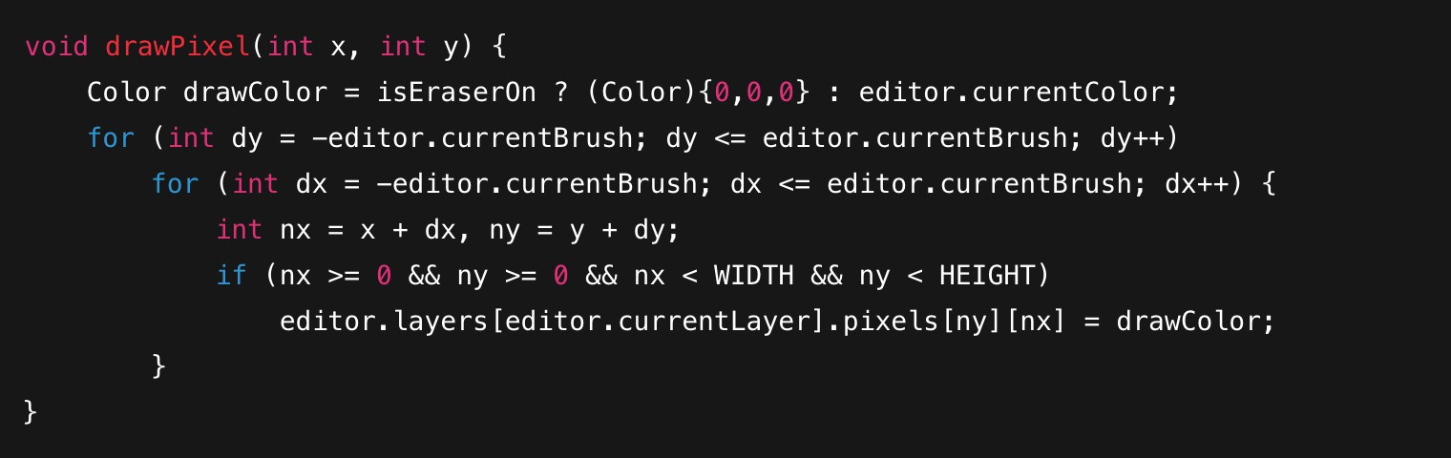
Draws with current brush radius Works for brush AND eraser Optimized to avoid bounds issues
PROJECT 6 JAMIL KABIR HRIDOY NAFIS UL ISLAM NAFIS MD. SHAIFUL ISLAM SALMAN FARSY

Slide 8
Color Palette + Brushes
Palette: 16 preset colors
ColorButton struct stores color + button area
Brushes: small (1), medium (2), large (3×3 area)
Switch with one click
(Side image: color palette + brush UI)
PROJECT 6 JAMIL KABIR HRIDOY NAFIS UL ISLAM NAFIS MD. SHAIFUL ISLAM SALMAN FARSY

Slide 9
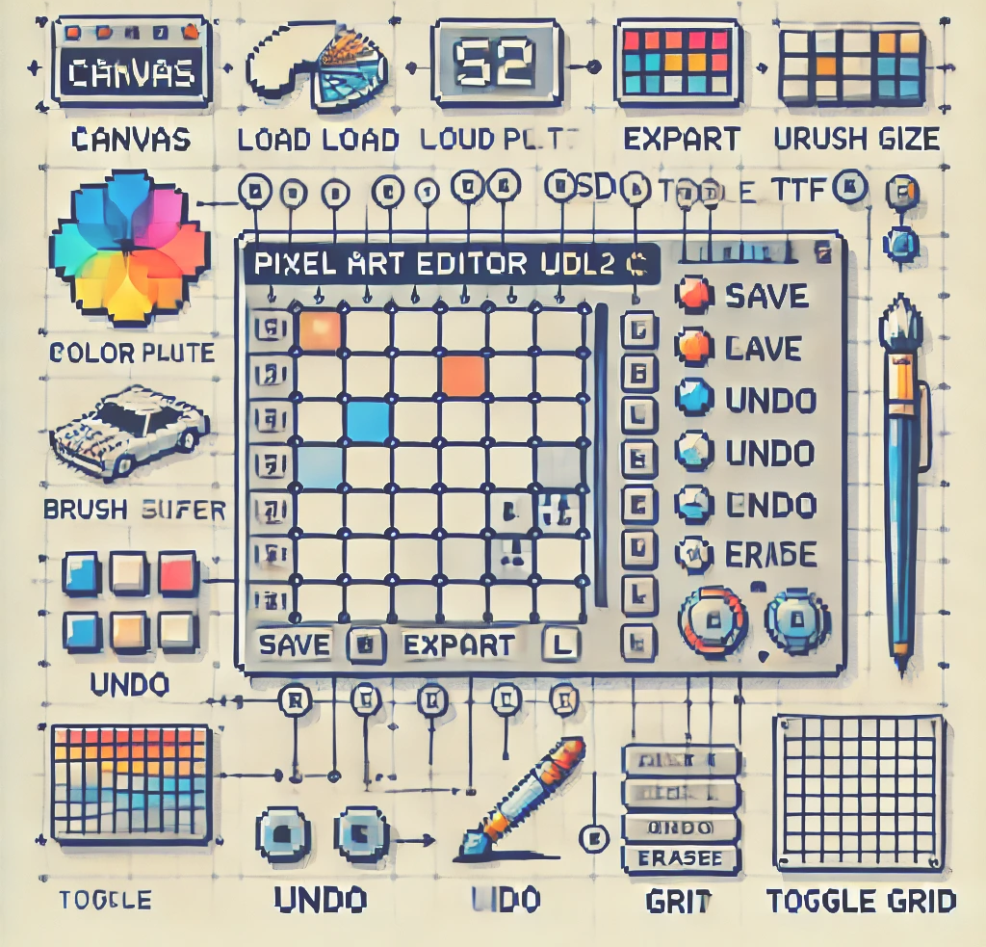
RENDERING UI + CANVAS
All UI drawn manually via SDL_Rect Buttons: brush sizes, color palette, actions
Text rendered using SDL_ttf
Grid lines toggled with a flag)
06
PROJECT 6 JAMIL KABIR HRIDOY NAFIS UL ISLAM NAFIS MD. SHA^{C}I^{an}F^{v}U^{as}L ISLAM SALMAN FARSY

Slide 10

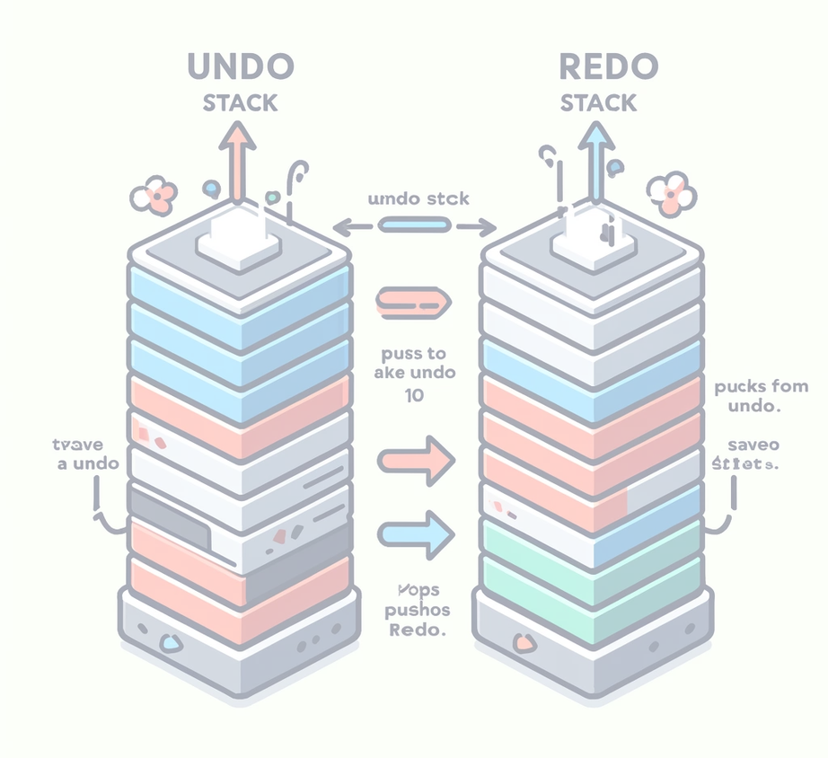


Undo / Redo Mechanism
Fixed-size stacks (MAX_UNDO = 10)
On draw: save previous layer state
Undo = pop from undo stack → push to redo
Redo = inverse
Keeps UI snappy and predictable (Side diagram: stacks and transitions)
PROJECT 6 JAMIL KABIR HRIDOY NAFIS UL ISLAM NAFIS MD. SHAIFUL ISLAM SALMAN FARSY

Slide 11
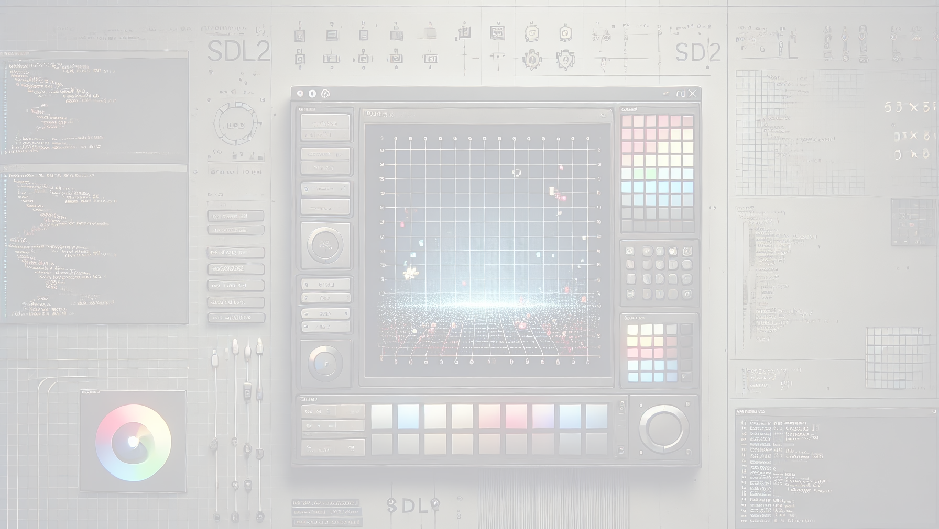
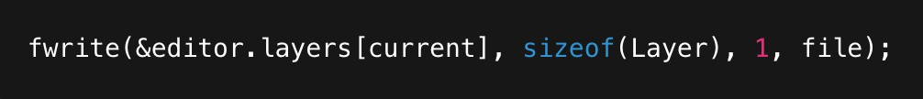
File Operations
Save/Load: raw fwrite/fread of Layer struct. c
Export:
Uses SDL_CreateRGBSurface()
Writes BMP via SDL_SaveBMP()
Keeps things lightweight and SDL-native
PROJECT 6 JAMIL KABIR HRIDOY NAFIS UL ISLAM NAFIS MD. SHAIFUL ISLAM SALMAN FARSY

Slide 12

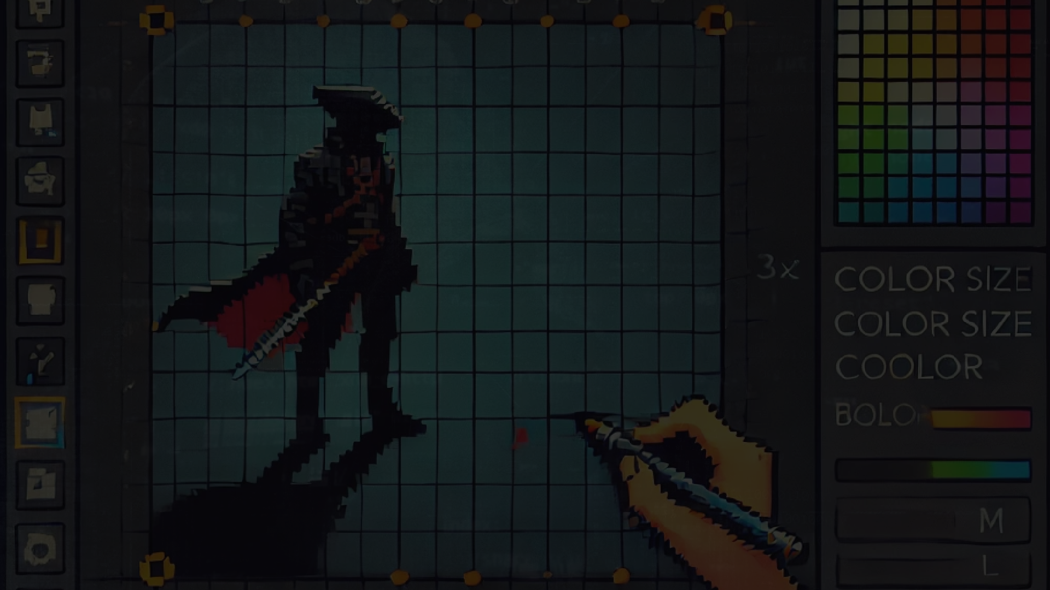
Structuring state cleanly without OOP.
Handling UI without a UI framework
Managing undo/redo efficiently
Learned a lot about real-time rendering & SDL events
PROJECT 6 JAMIL KABIR HRIDOY NAFIS UL ISLAM NAFIS MD. SHAIFUL ISLAM SALMAN FARSY

Slide 13
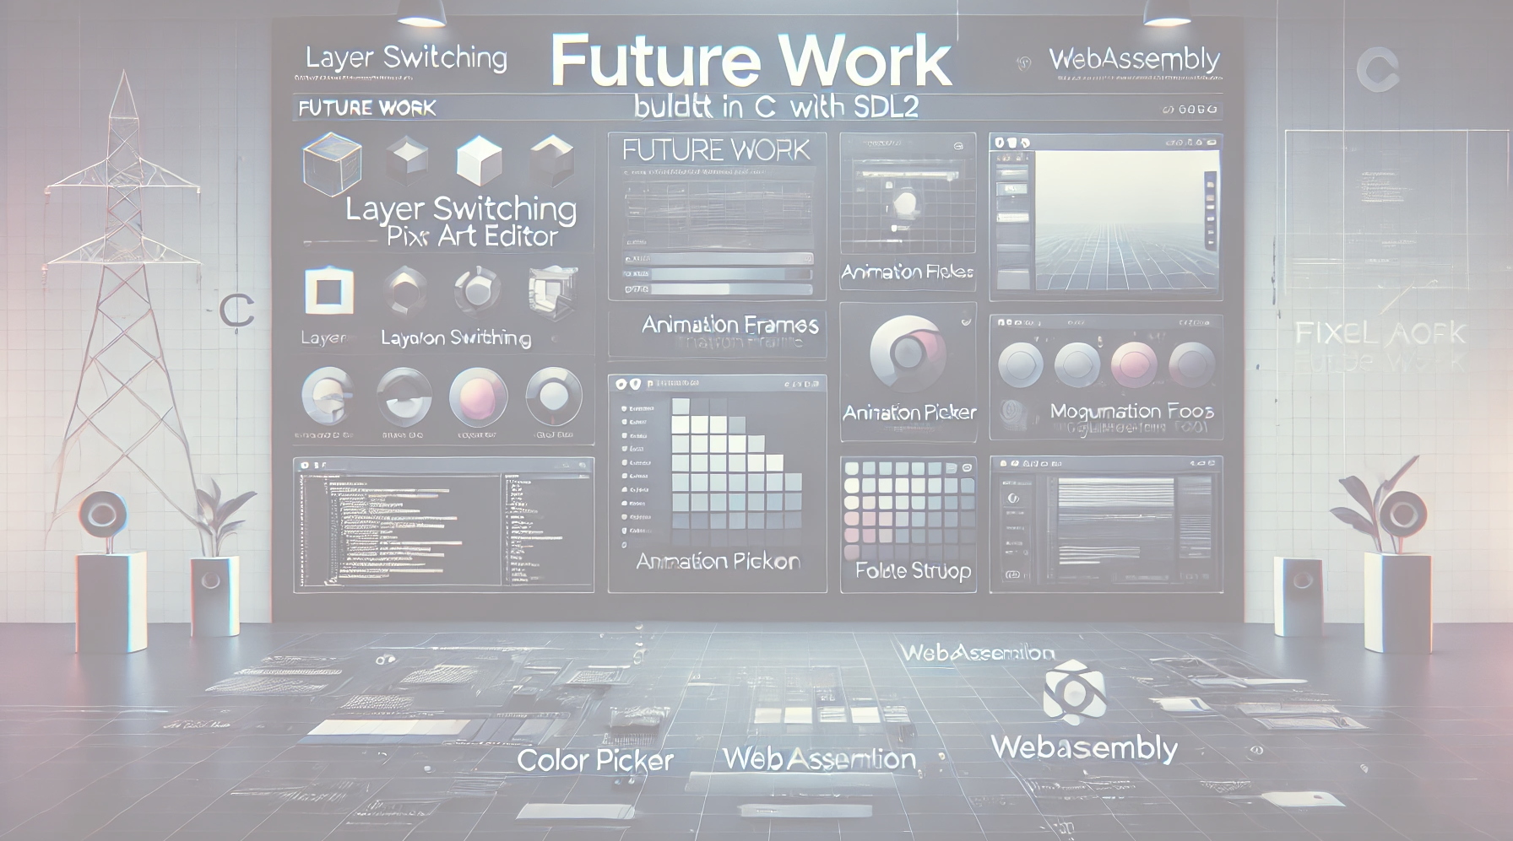

Future Work Add:
Layer switching
Frame-by-frame Animation
Custom color picker
Maybe : migrate to WebAssembly for browser version Modularize: break down into smaller files for maintainability
PROJECT 6 JAMIL KABIR HRIDOY NAFIS UL ISLAM NAFIS MD. SHAIFUL ISLAM SALMAN FARSY

Slide 14

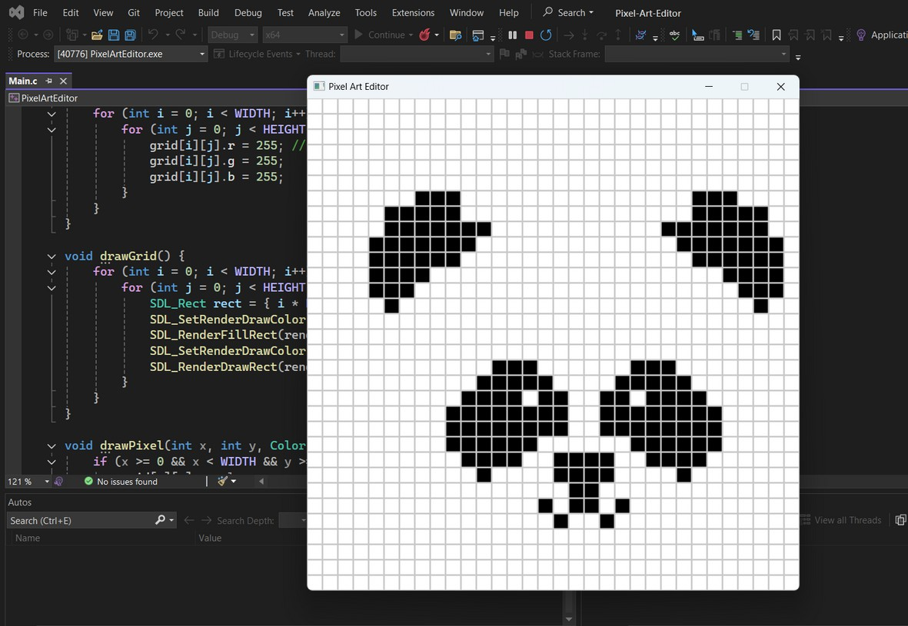
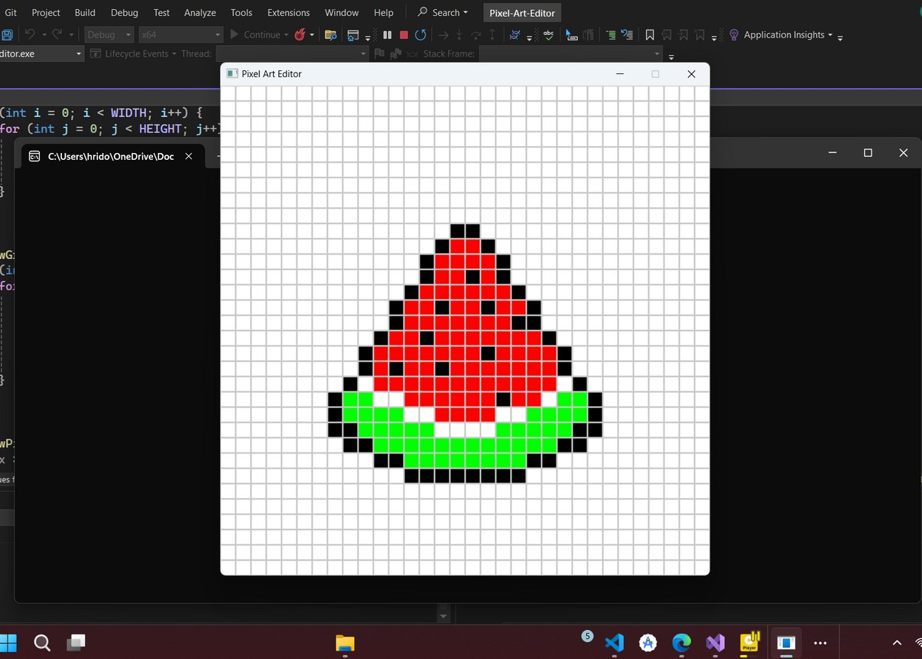
PREVIOUS SAMPLE ARTS
PROJECT 6 JAMIL KABIR HRIDOY NAFIS UL ISLAM NAFIS MD. SHAIFUL ISLAM SALMAN FARSY

Slide 15

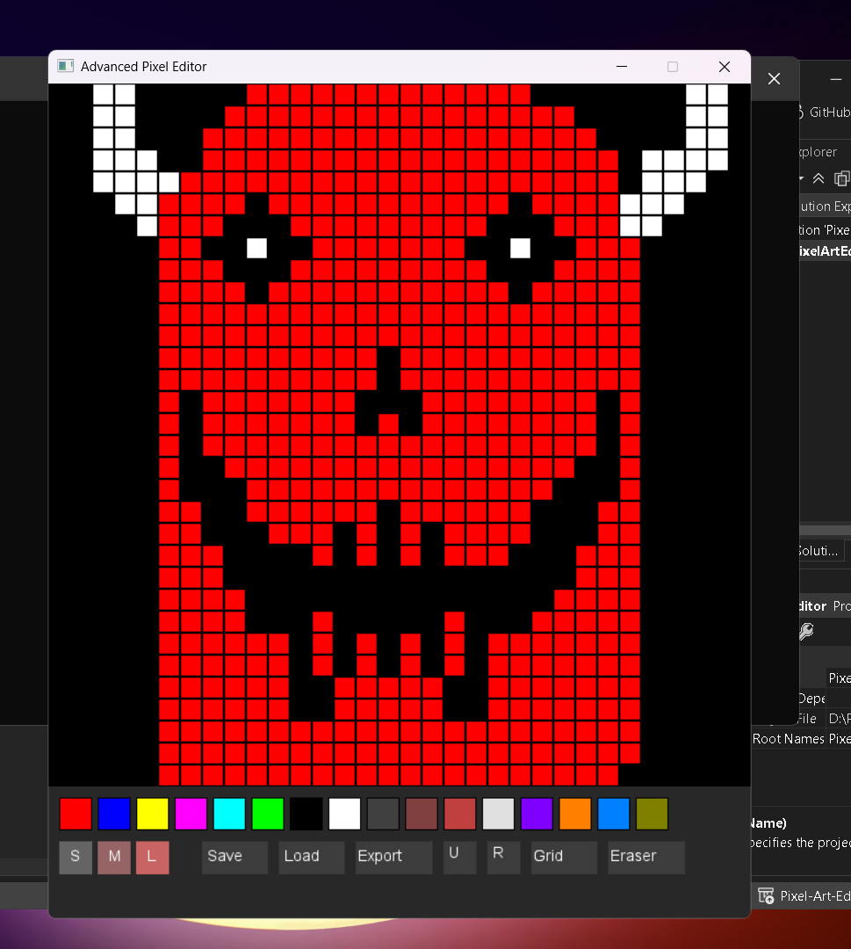
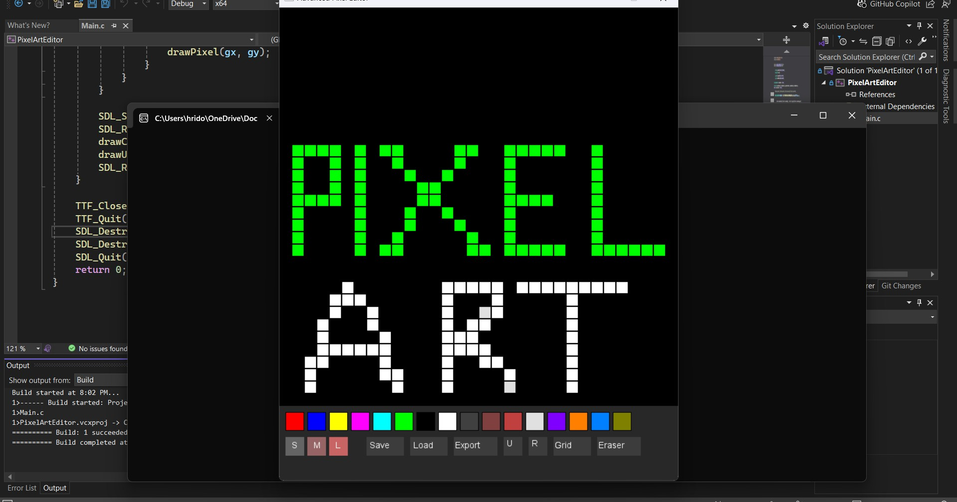
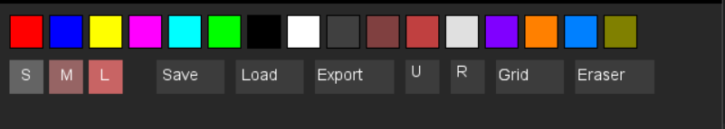
Sample Art
PROJECT 6 JAMIL KABIR HRIDOY NAFIS UL ISLAM NAFIS MD. SHAIFUL ISLAM SALMAN FARSY

Slide 16











Thank
You
PROJECT 6 JAMIL KABIR HRIDOY NAFIS UL ISLAM NAFIS MD. SHAIFUL ISLAM SALMAN FARSY

